Slide 1


THE B PILLS
Just In Time group
Stefano Tonini
Jacopo Dallafior
Lorenzo Sciotto

Slide 2

Idea
The B pills
BOTTLES
BOTTLE FILLING MACHINE
CARTONING MACHINE
SHIPPING
MIXING STATION
COMPRESSION MACHINE
TAG MACHINE
BLISTER
BLISTER FILLING MACHINE
CARTONING MACHINE
SHIPPING
The B pills

Slide 3
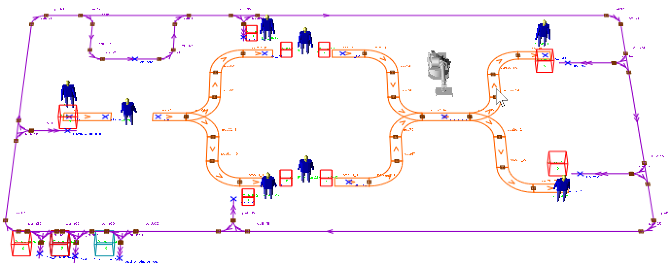
Model configuration
AS-IS

Slide 4
Automod Code
P_read: Read csv input file
P_powder: Retrieve raw powder
P_rawB: Retrieve empty bottle and blister and deliver to
P_mixing: Compress raw powder
P_conv: Fill bottle and blister and cartoned them
P_ship: Tag and deliver finished box to the depot
L_dummy
P_read
P_powder
P_rawB
P_mixing
P_conv
P_ship
Automod Code

Slide 5
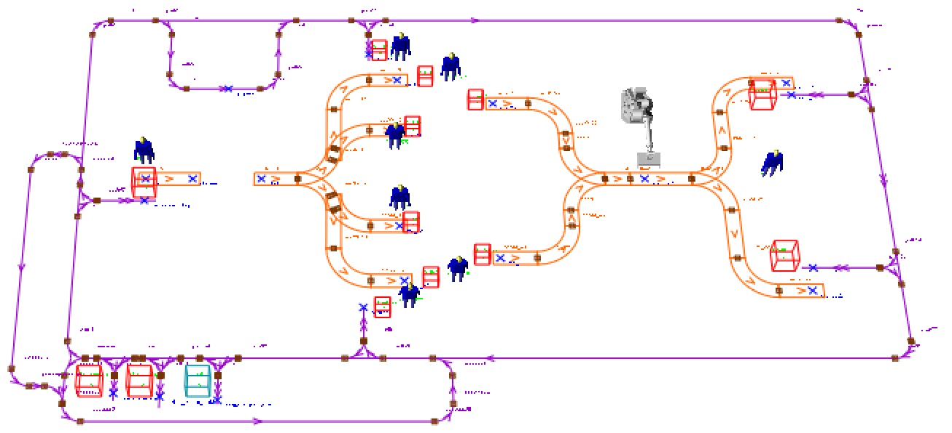
Model configuration
TO-BE

Slide 6
Evaluation with Business graphs
Resource Utilization Rate: This KPI measures the percentage of time the resource are actively engaged in processing loads versus idle time. High utilization rates indicate efficient use of resources
Average Time in the System: It measures the average time a load spends inside the different queues assembly line, from entry to exit.
Forklift Utilization Rate: This KPI measures the percentage of time the forklifts are actively engaged in moving loads versus idle time. High utilization rates indicate efficient use of equipment
Business Graphs

Slide 7
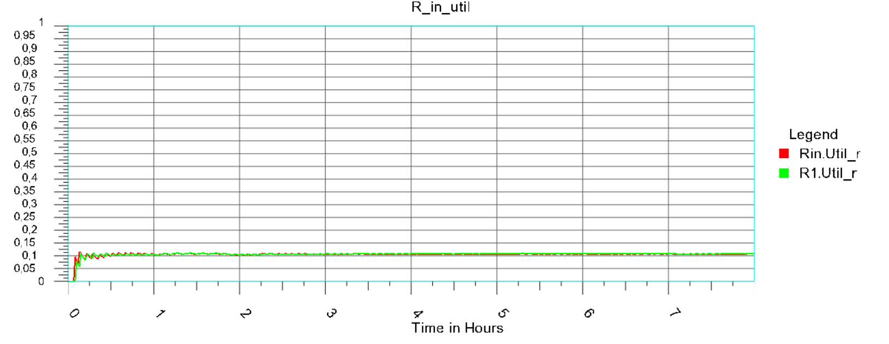
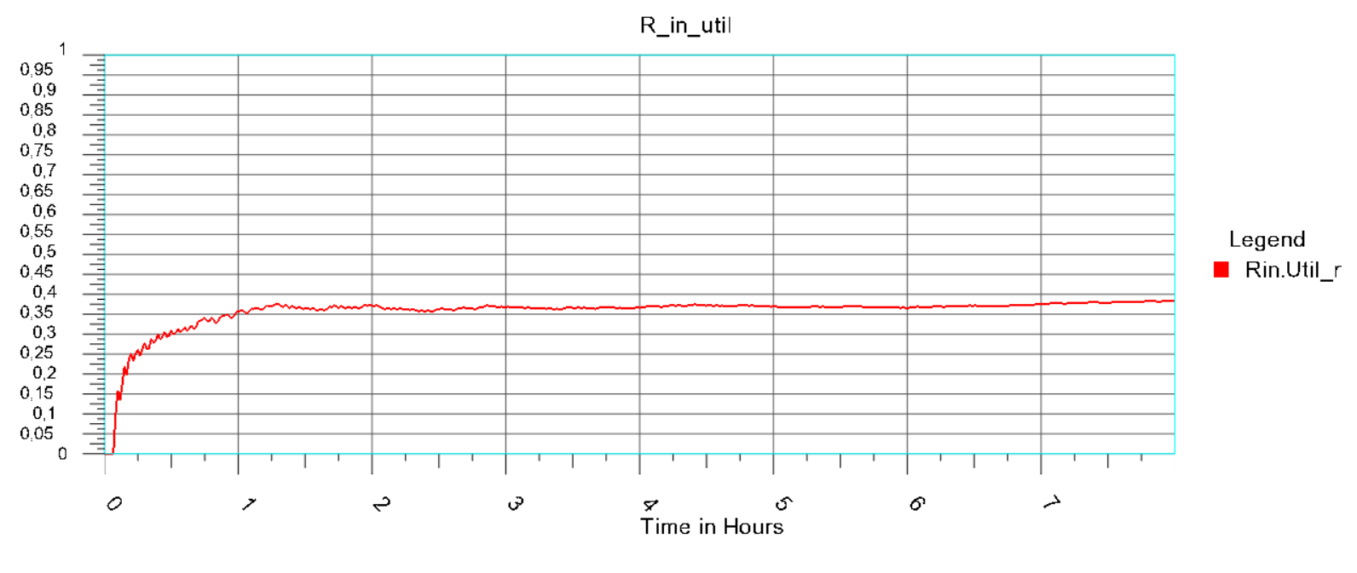
Resource Utilization Rate
AS-IS
TO-BE
Resource Utilization Rate

Slide 8
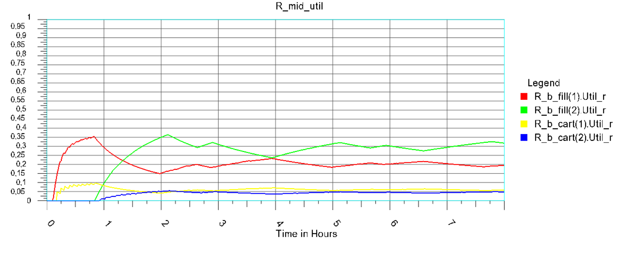
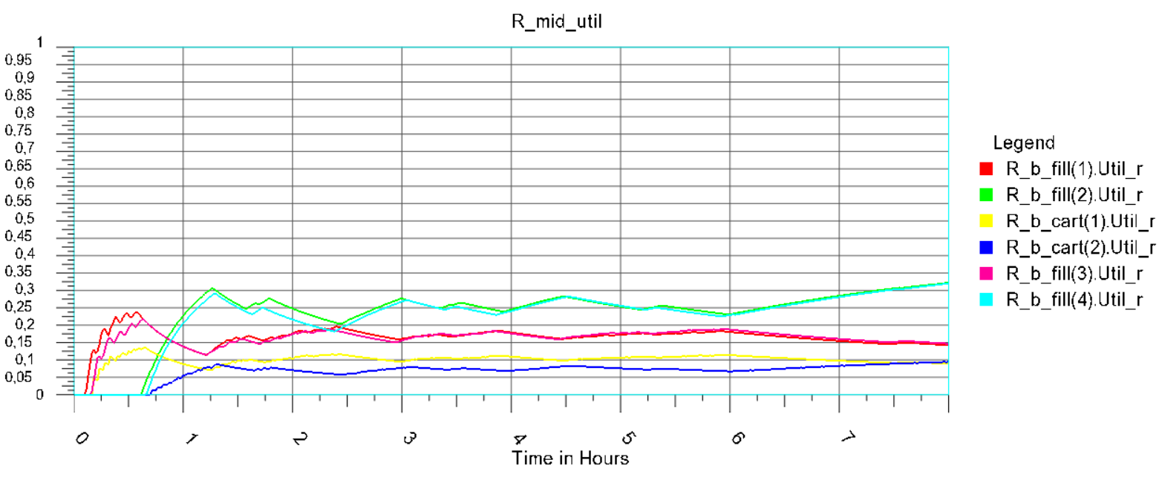
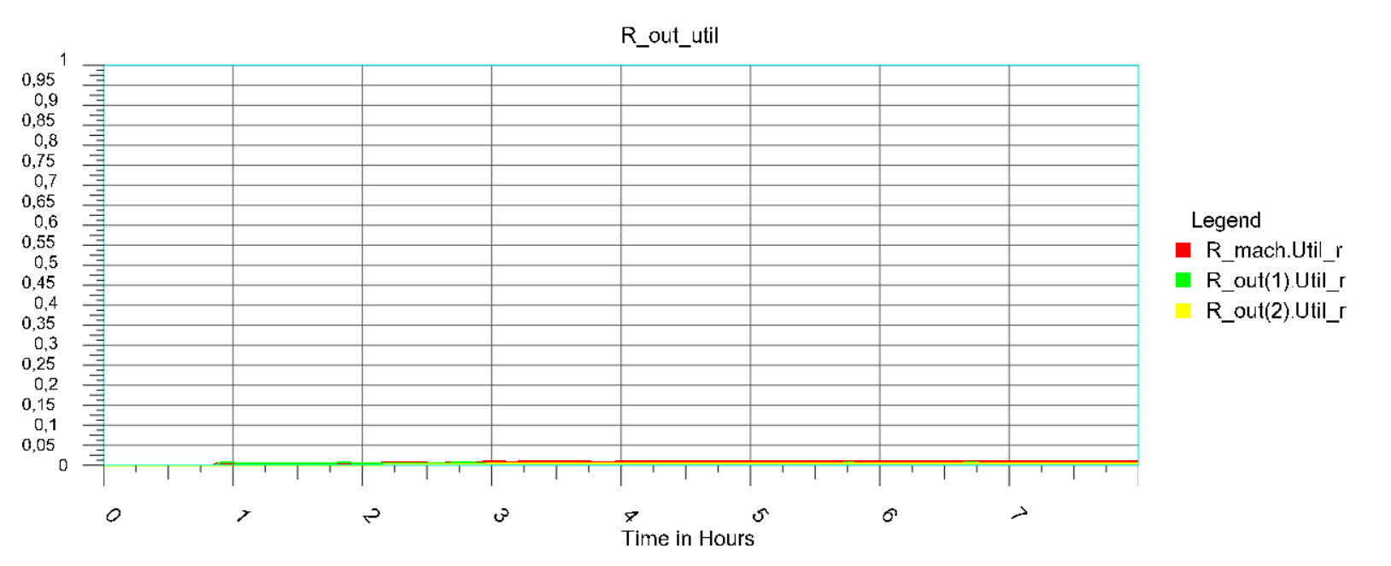
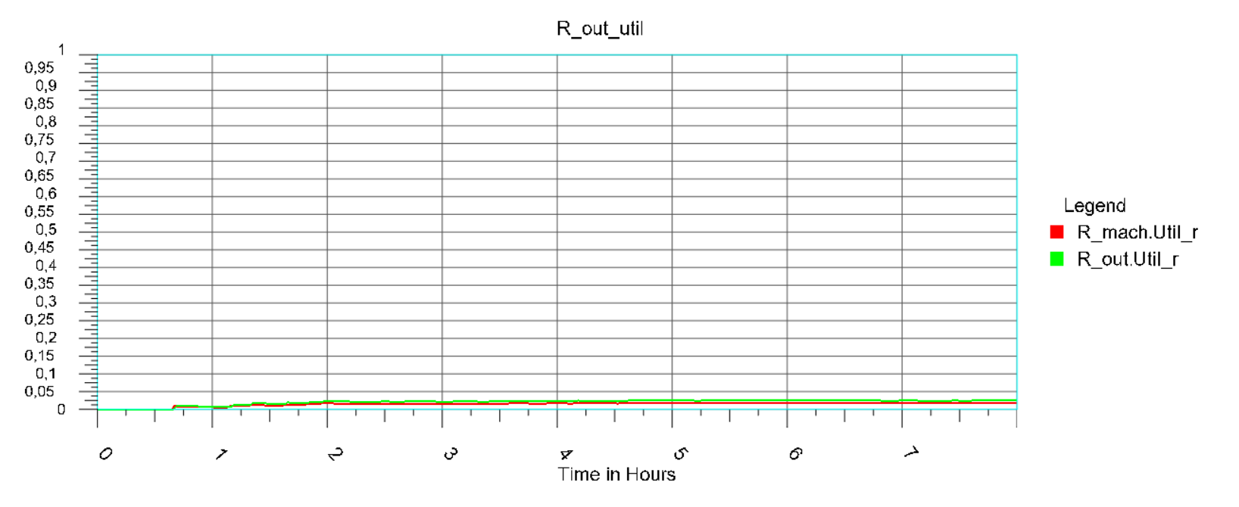
Resource Utilization Rate
AS-IS
TO-BE
Resource Utilization Rate

Slide 9
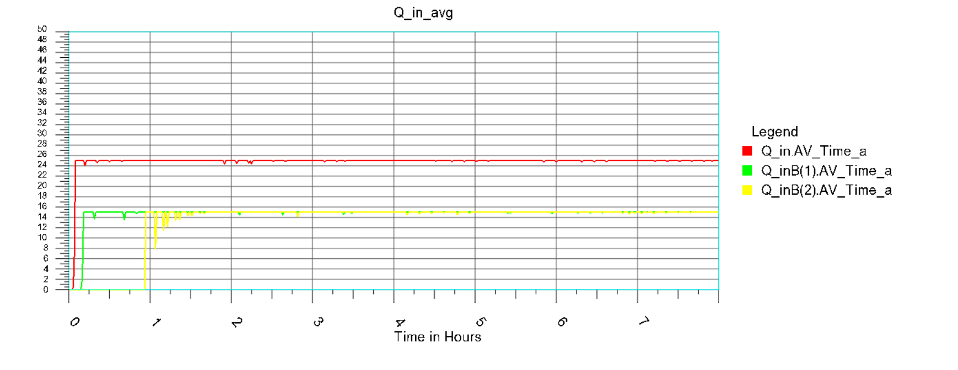
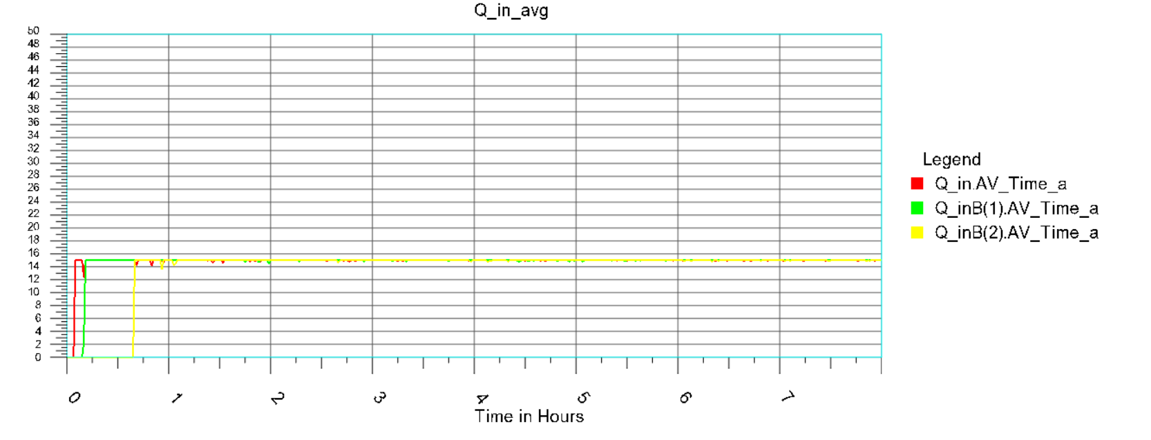
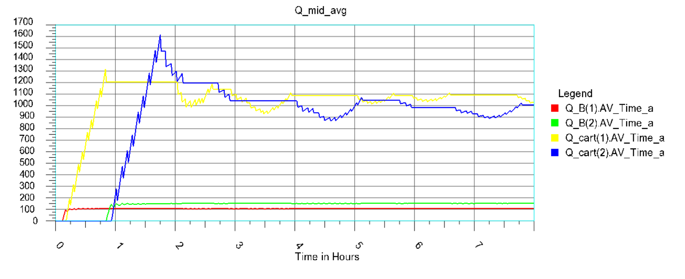
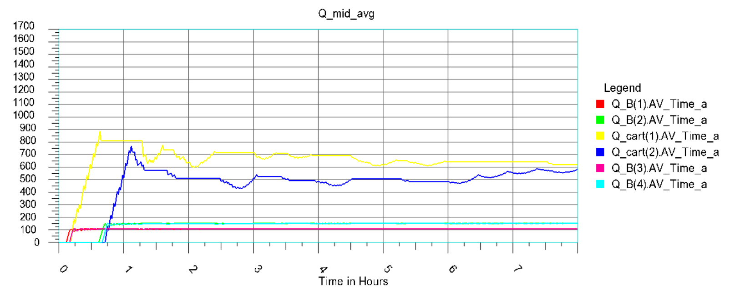
Average Time in the System
AS-IS
TO-BE
Average Time in the System

Slide 10
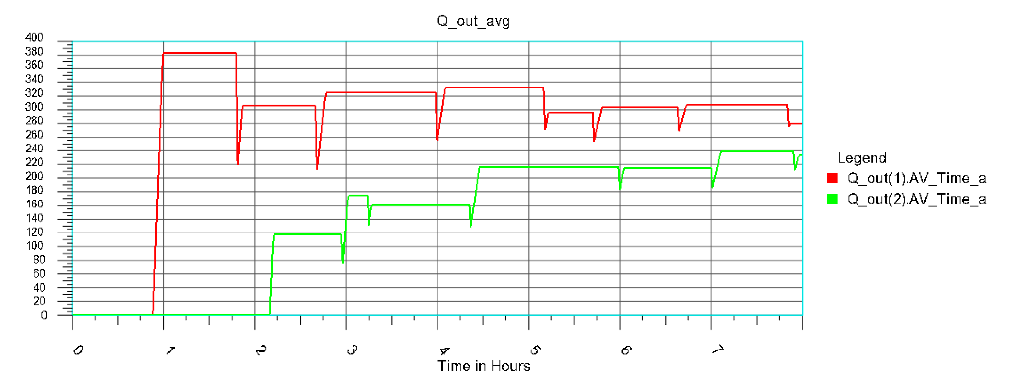
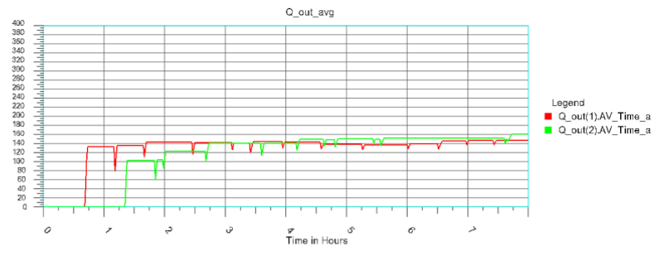
Average Time in the System
AS-IS
TO-BE
Average Time in the System

Slide 11
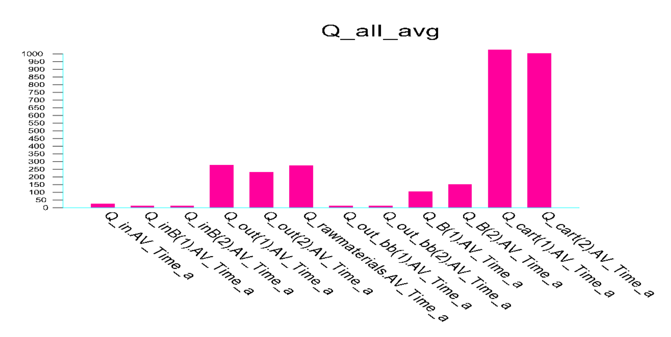
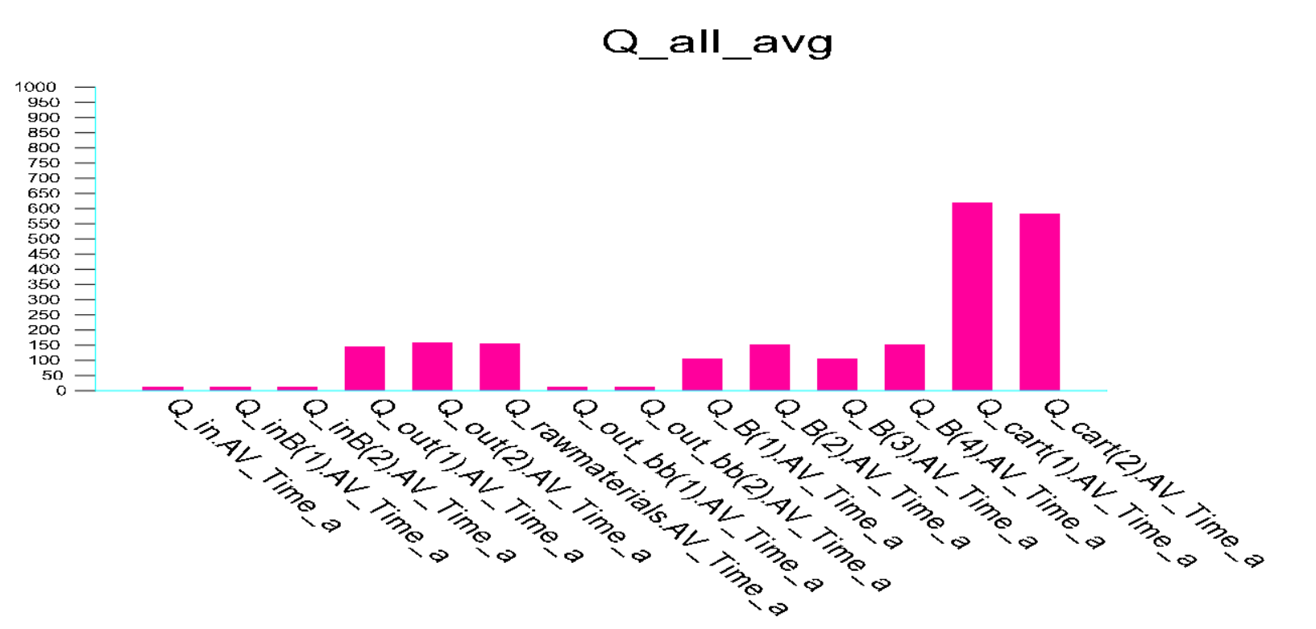
Average Time in the System
AS-IS
TO-BE
Average Time in the System

Slide 12
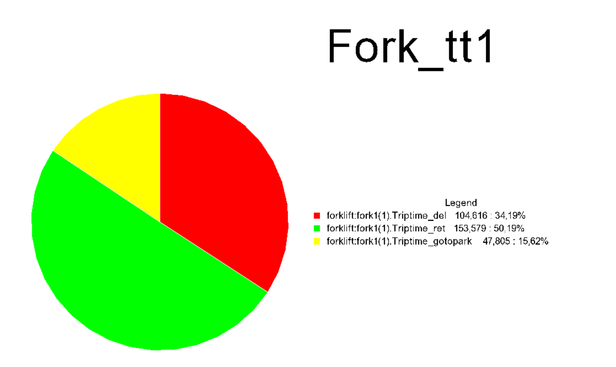
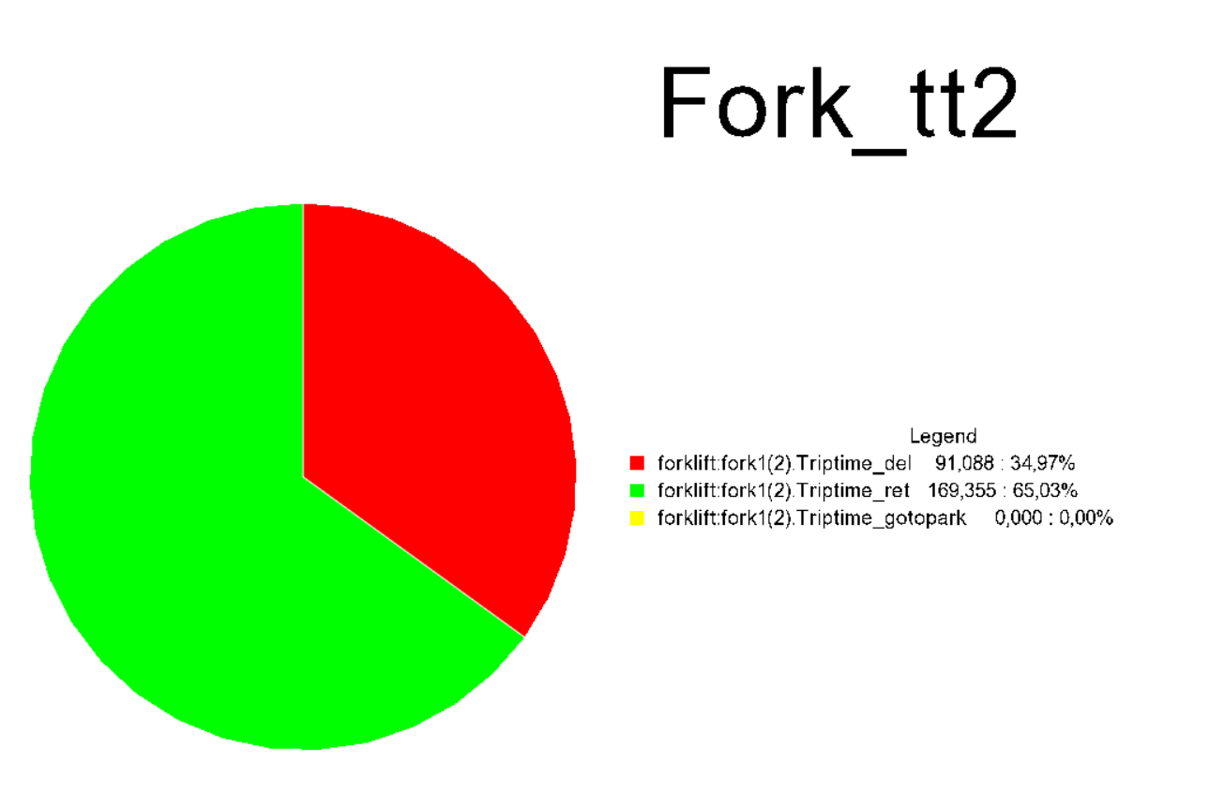


Forklift Utilization Rate
AS-IS
Forklift Utilization Rate

Slide 13
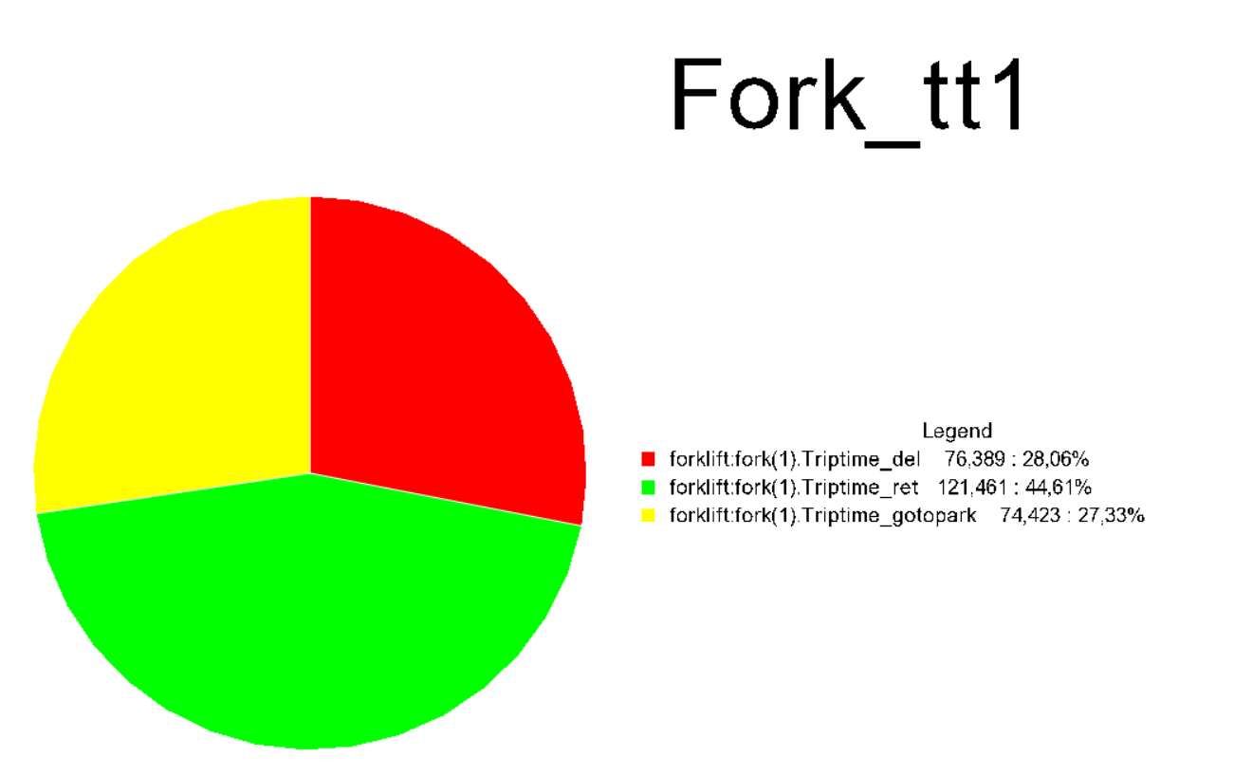
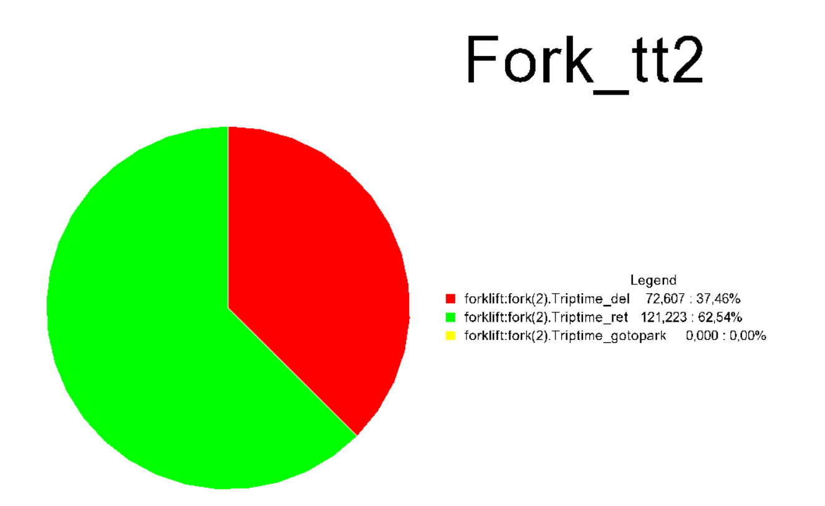


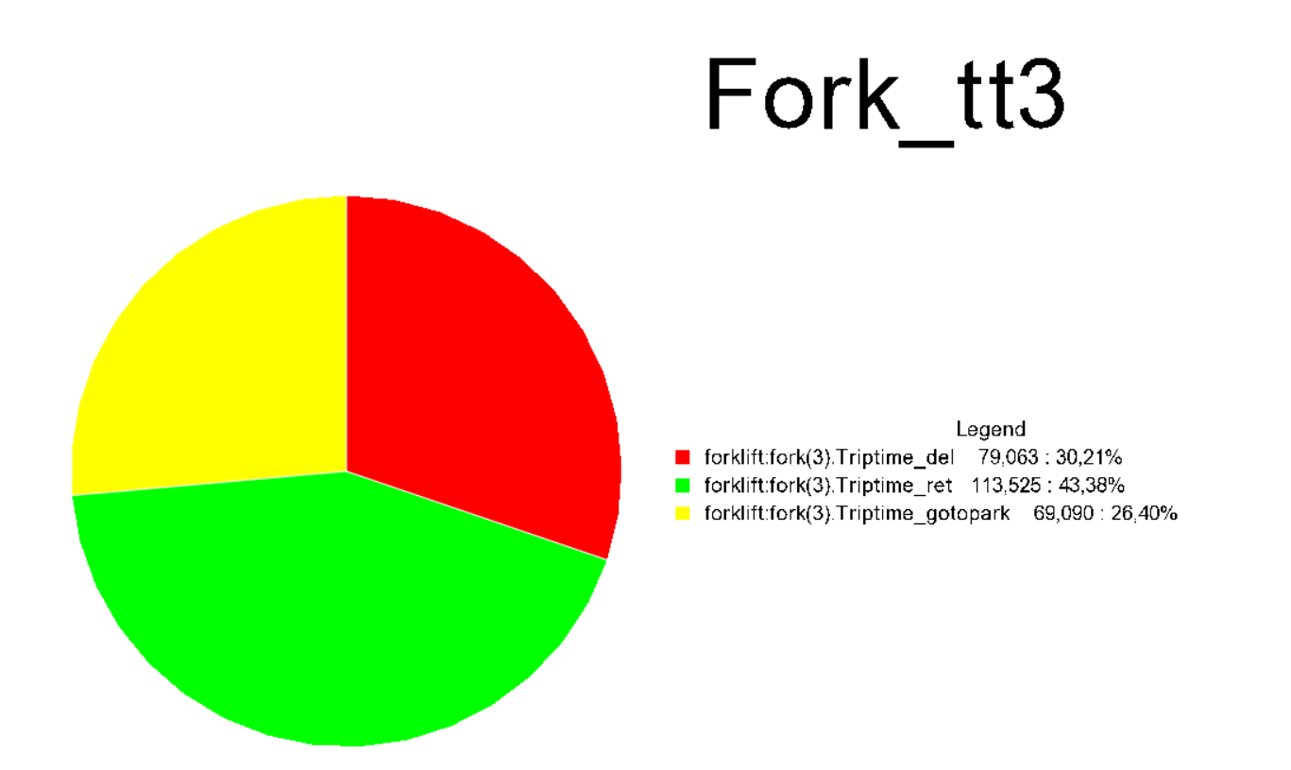

Forklift Utilization Rate Rate
TO-BE
Forklift Utilization Rate

Slide 14
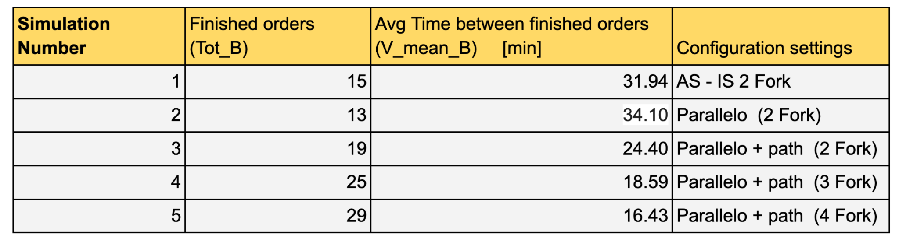
Final Results
Forklift Utilization Rate

Slide 15
THANKS

